Slide 1
Machine Learning
MATH42815
Friday January 19th 2024

Slide 2
Week 2
Practical 4:
Ridge regression
Lecture 3:
Step functions, polynomials, and splines
Practical 5:
Lasso regression; maybe some PCR
Practical 6:
Step functions, polynomials, and splines
Lecture 4:
Logistic Regression and Decision Trees

Slide 3
Apologies
Misattributed some graphs I sourced from last year’s course notes, which originated in textbook Introduction to Statistical Learning with Applications in R by James et al. (2013)
Will upload correctly attributed version of lecture slides soon
If you want more detail on the content of today’s lecture, please see Chapter 8 of the above

Slide 4
Lecture 4 Outline
Revision of ISDS Week 9
Logistic Regression
Classification Error
Linear Discriminant Analysis
Decision Trees (Conceptually)
Algorithm For Creating Decision Trees

Slide 5
Logistic Regression

Slide 6
What is Logistic Regression?
Until now, all our “supervised machine learning” has involved a continuous output variable
In ISDS, you covered dummy variables and their use for categorical feature variables
How do we model a categorical output variable?
Binary output variable: Logistic regression! (See: ISDS Video 9.2)
General categorical variable: Classification tree!

Slide 7
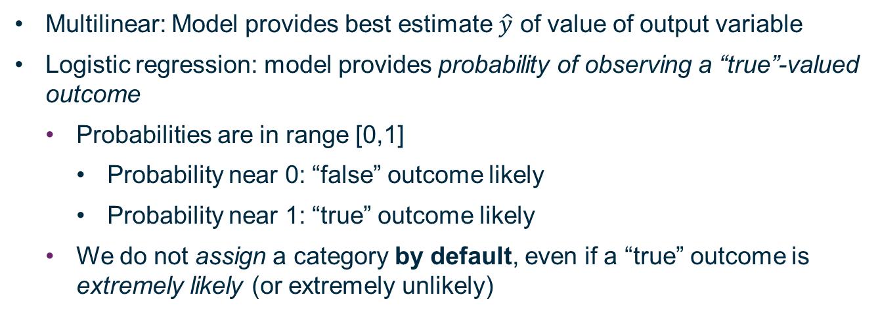
Differences from Multilinear Regression
Multilinear: Model provides best estimate $\hat{y}$ of value of output variable
Logistic regression: model provides probability of observing a “true”-valued outcome
Probabilities are in range [0,1]
Probability near 0: “false” outcome likely
Probability near 1: “true” outcome likely
We do not assign a category by default, even if a “true” outcome is extremely likely (or extremely unlikely)

Slide 8
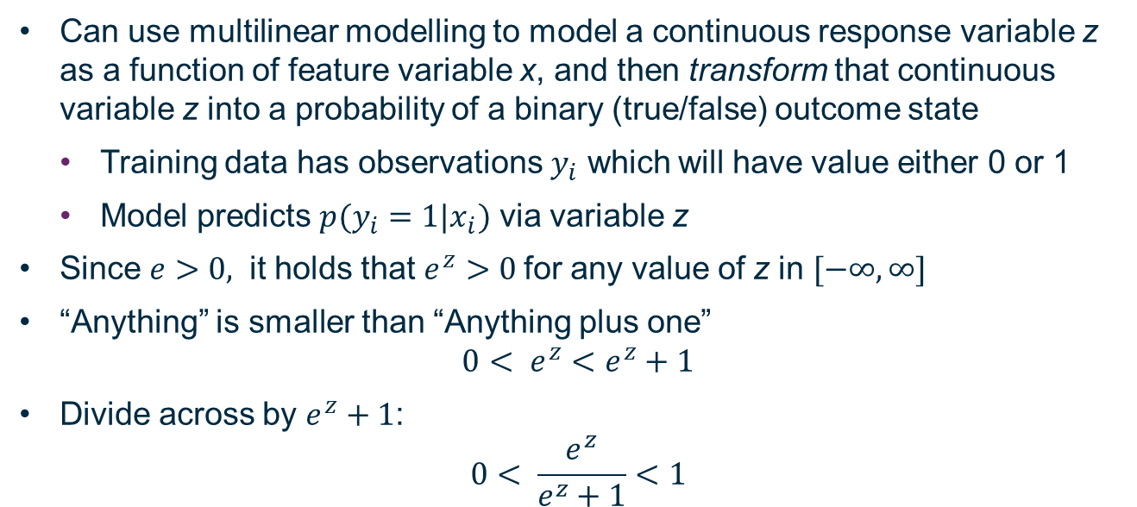
Logistic Function
Can use multilinear modelling to model a continuous response variable z as a function of feature variable x, and then transform that continuous variable z into a probability of a binary (true/false) outcome state
Training data has observations $y_{i}$ which will have value either 0 or 1
Model predicts $p(y_{i}=1|x_{i})$ via variable z
Since $e>0,$ it holds that $e^{z}>0$for any value of z in $[−∞,∞]$
“Anything” is smaller than “Anything plus one”
$$0< e^{z}<e^{z}+1$$
Divide across by $e^{z}+1$:
$$0< \frac{e^{z}}{e^{z}+1}<1$$

Slide 9
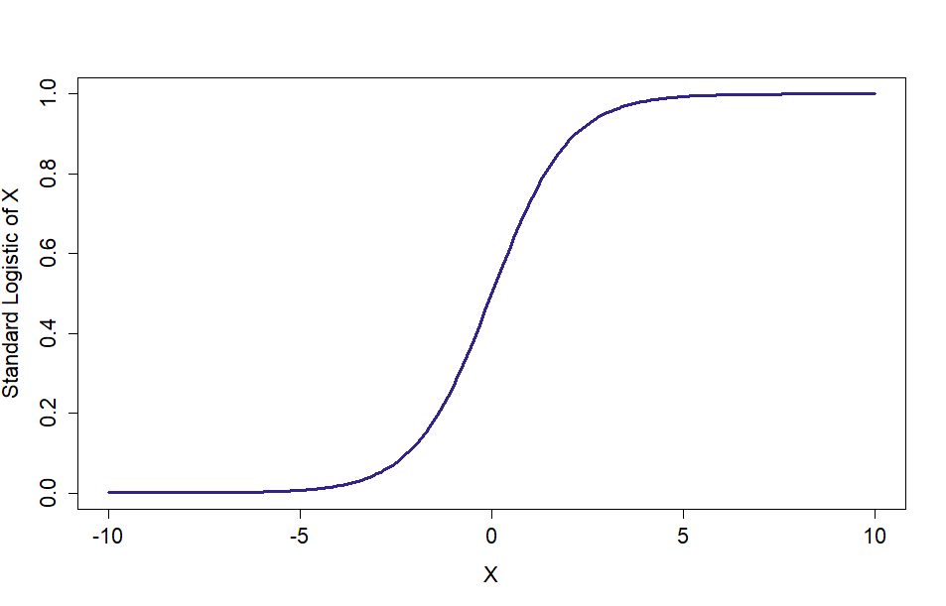
Graph of Logistic Function

Slide 10
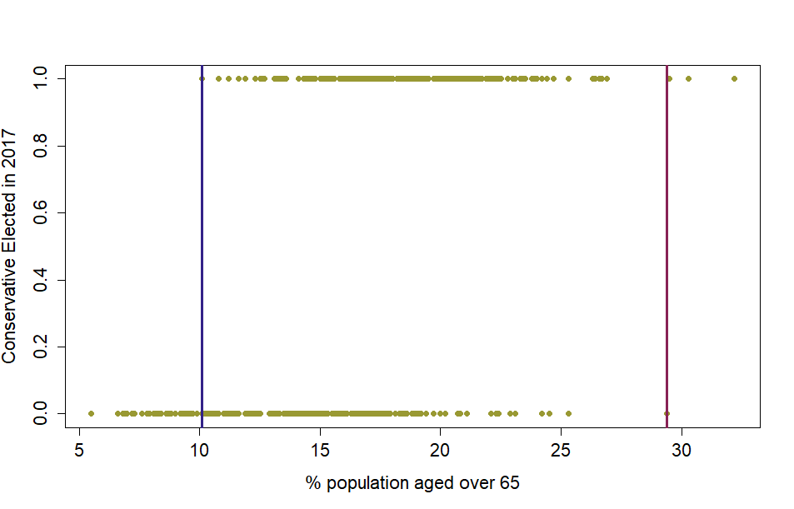
Election Data

Slide 11
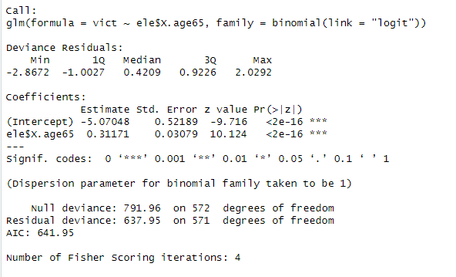
Fitting Logistic Regression In R

Slide 12

Calculate usual model output, then transform
$$Z=β_{0}+β_{1}X$$
$$p\left(Y=1\right)= \frac{e^{z}}{1+e^{z}}$$

Slide 13
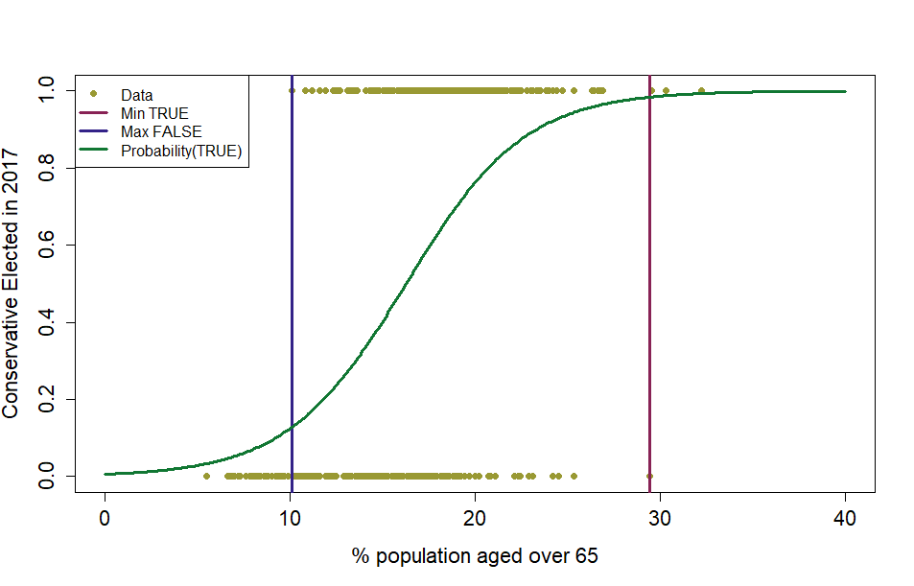
Model of Probability of True Outcome

Slide 14
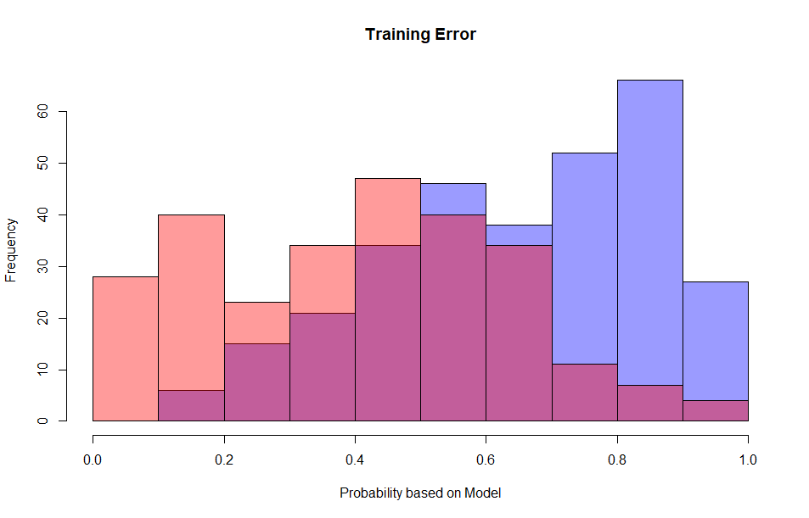
Training Error

Slide 15
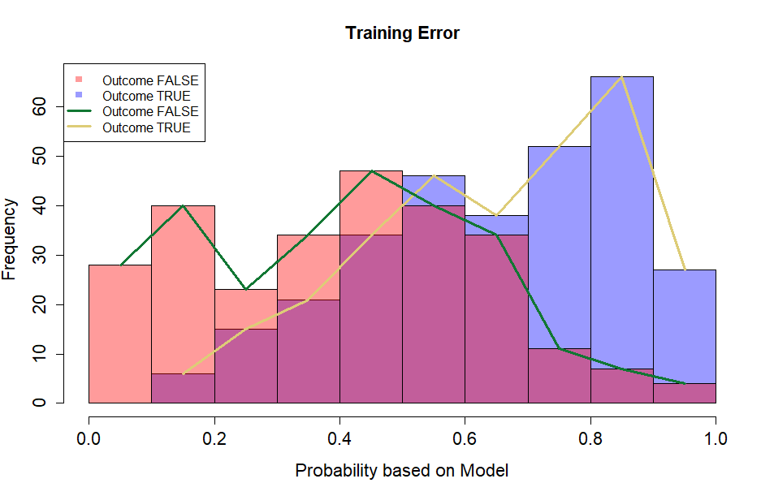
Training Error (With Line)

Slide 16
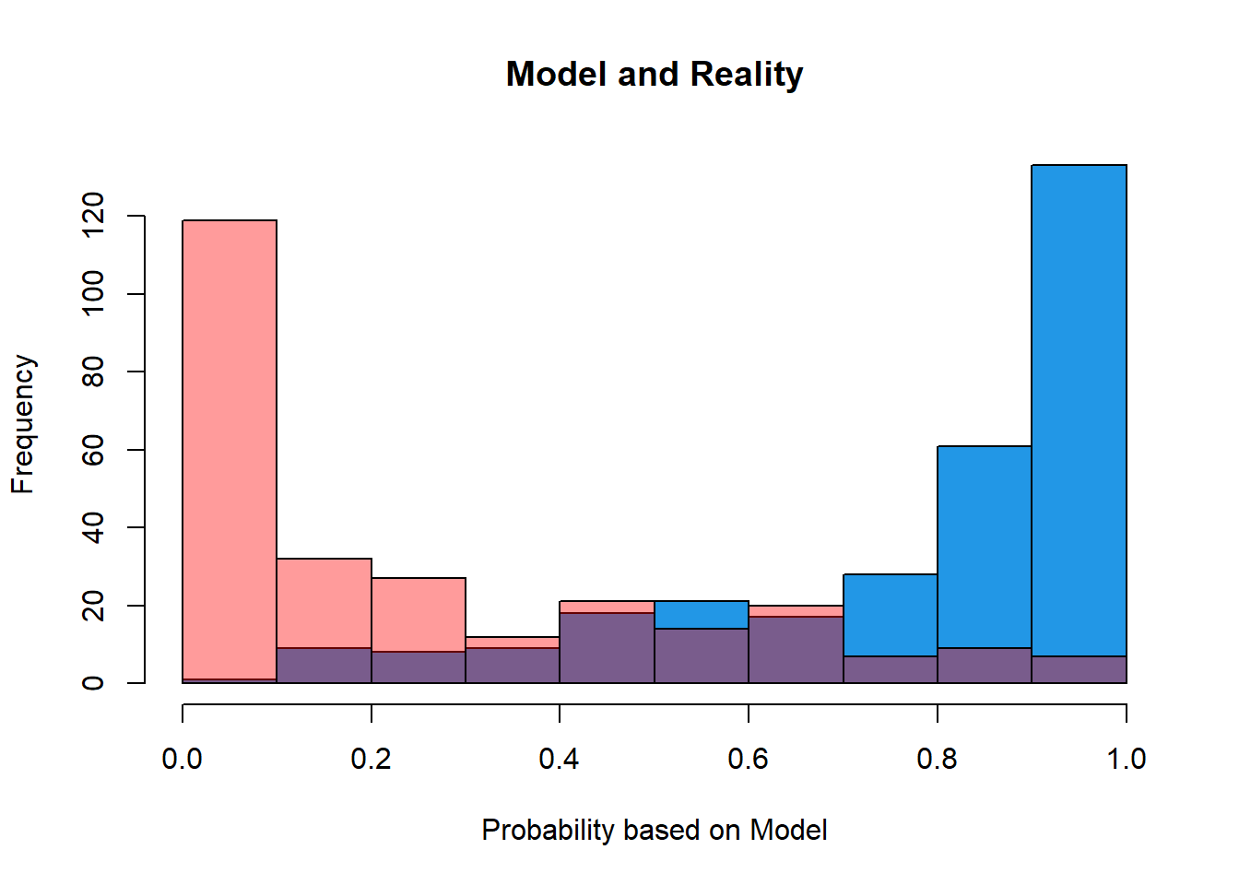
Can make a better logistic model for this response!

Slide 17

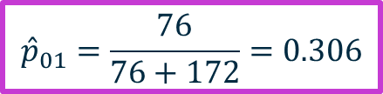
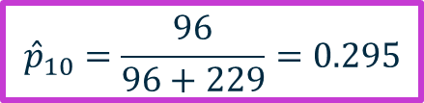
Measure of Model Quality: Misclassification Table
Reality Model | TRUE | FALSE
TRUE | 229 | 96
FALSE | 76 | 172
$${\hat{p}}_{10}=\frac{96}{96+229}=0.295$$
$${\hat{p}}_{01}=\frac{76}{76+172}=0.306$$
Accuracy: $\frac{229+172}{229+96+76+172}=\frac{401}{573}=0.6998$
“Null model” accuracy: 0.53

Slide 18
Classification Error

Slide 19
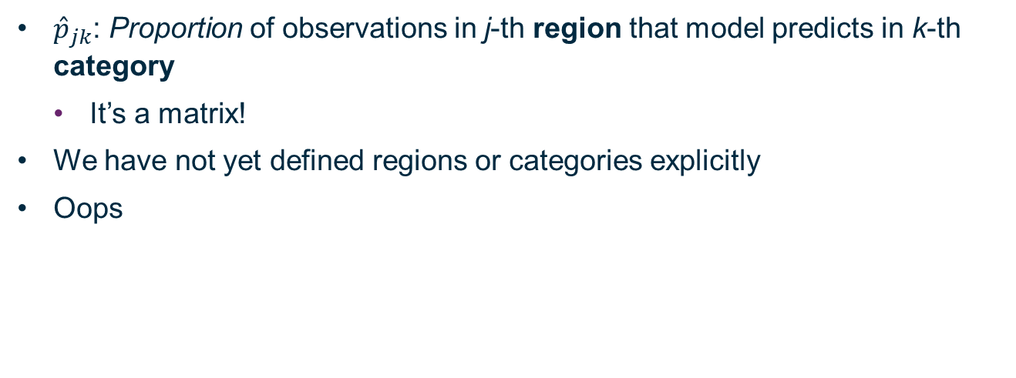
For general classification model (not just binary)
${\hat{p}}_{jk}$: Proportion of observations in j-th region that model predicts in k-th category
It’s a matrix!
We have not yet defined regions or categories explicitly
Oops

Slide 20
Discriminant Analysis

Slide 21
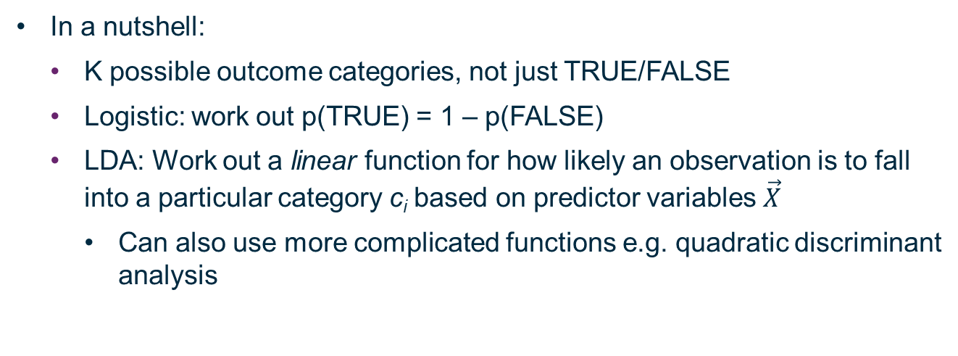
See ISDS Video 9.3
In a nutshell:
K possible outcome categories, not just TRUE/FALSE
Logistic: work out p(TRUE) = 1 – p(FALSE)
LDA: Work out a linear function for how likely an observation is to fall into a particular category c_{i} based on predictor variables $\vec{X}$
Can also use more complicated functions e.g. quadratic discriminant analysis

Slide 22

Model of Probability of True Outcome
$$α=0.5$$
17.9%

Slide 23
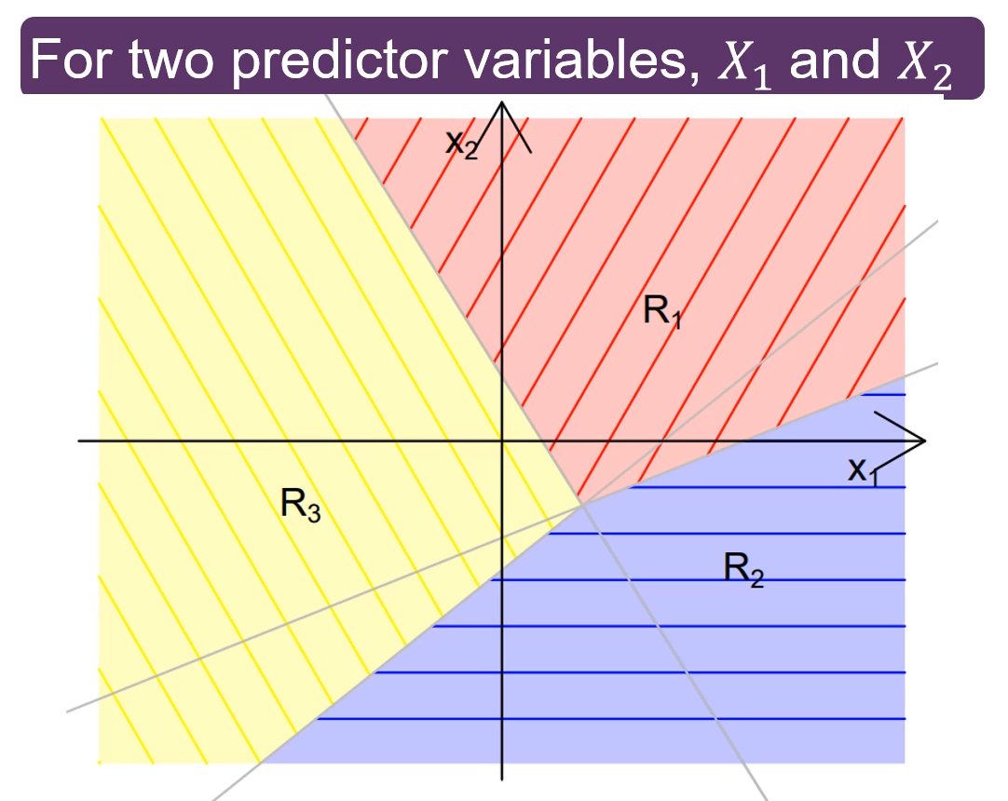
Two Predictor Variables, 3 Outcome Values (ISDS Video 9.3)

Slide 24
Model of Probability of True Outcome
17.9%

Slide 25
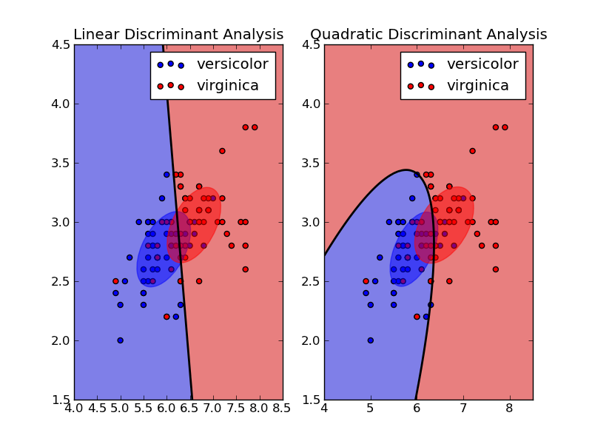
Discriminant Analysis

Slide 26
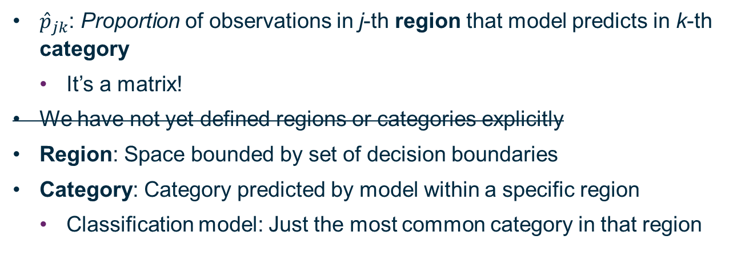
For general classification model (not just binary)
${\hat{p}}_{jk}$: Proportion of observations in j-th region that model predicts in k-th category
It’s a matrix!
We have not yet defined regions or categories explicitly
Region: Space bounded by set of decision boundaries
Category: Category predicted by model within a specific region
Classification model: Just the most common category in that region

Slide 27
Decision Trees: Categorical Features, Categorical Response

Slide 28
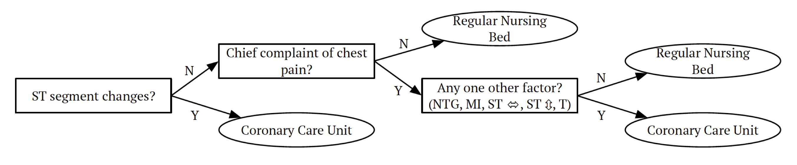
Conceptually: outcome results from decisions!
Note:
Response variable and all feature variables categorical in this instance
Data can be thought of as hyperspace of [TRUE/FALSE] options
Think in terms of TRUE/FALSE for each space rather than combinations of dummy variables of TRUE/FALSE
This can be helpful because once you start thinking that way, you can switch to continuous feature variables just by joining your TRUE/FALSE states with lines

Slide 29
Reality: Other factors come into play
…what happens if there are no beds?

Slide 30
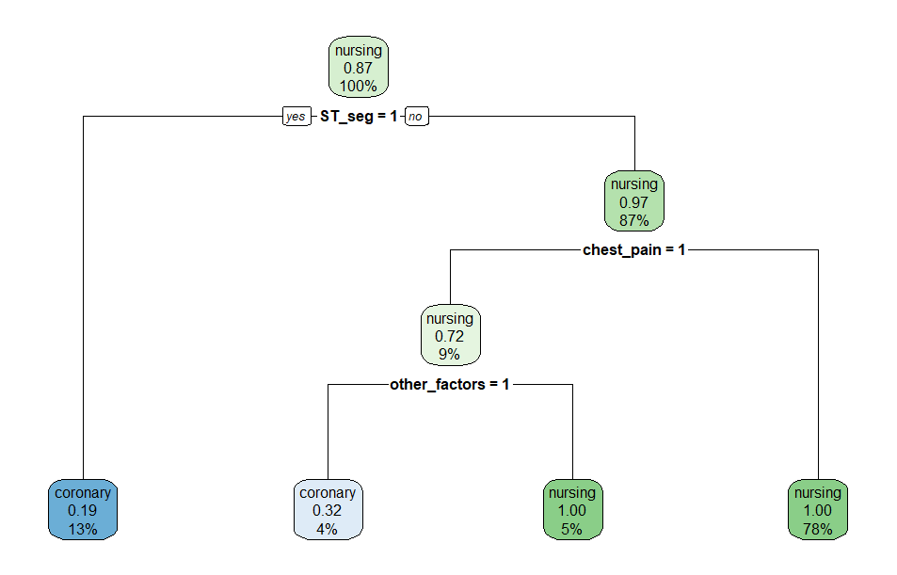
Decision Tree Data
ST_seg: 12%
Chest pain: 9%
Other: 30%
Coronary full: 20%
Nursing full: 10%
If Coronary and Nursing both full, missing output (set to NA)

Slide 31
Decision Tree Data
% of good data used to train model
ST_seg: 12%
Chest pain: 9%
Other: 30%
Coronary full: 20%
Nursing full: 10%
If Coronary and Nursing both full, missing output (set to NA)

Slide 32
Decision Tree Data
Proportion of observations in majority category (binary)
ST_seg: 12%
Chest pain: 9%
Other: 30%
Coronary full: 20%
Nursing full: 10%
If Coronary and Nursing both full, missing output (set to NA)
100% of data are in root node
All are assigned outcome “nursing”
87% of observations are correctly labelled “nursing”
⇒ 0.87
13% of data in ST_seg == TRUE node
122 observations
99 labelled “coronary”
23 labelled “nursing”
19% of observations are incorrectly labelled “nursing”
⇒ 0.19

Slide 33
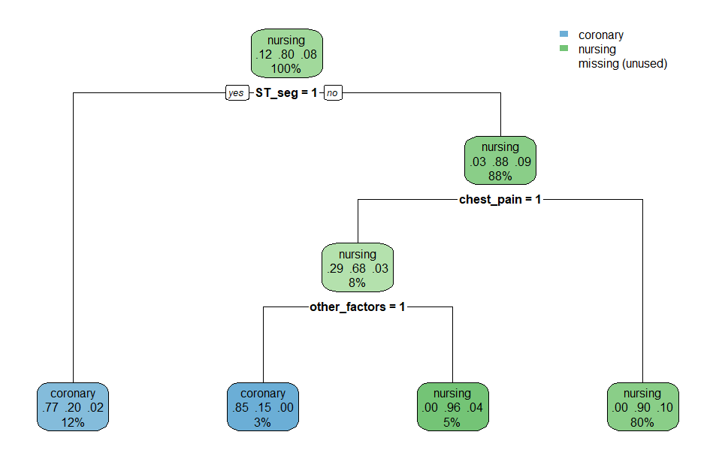
What if I add an explicit “missing data” category?
Data all “good” now!
No nodes actually labelled “missing”
Why?
Graph shows proportion of data in node for each of the categories!
Not just overall majority category

Slide 34

Different random iteration – try to track the flow!

Slide 35
Do as I say, not as I do
I have not run any kind of validation or testing on this model
Why is this okay?
Because all I am using the model for is to teach you what this kind of model looks like
Always validate your model using the techniques covered in earlier workshops!

Slide 36
Decision Trees: Continuous Features, Categorical Response

Slide 37
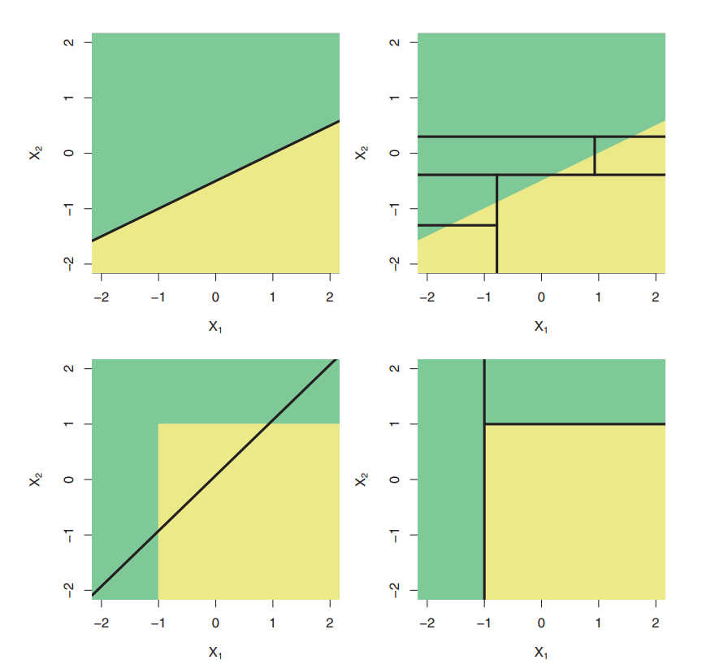
Figure 8.7
James et al.

Slide 38
Discriminant Analysis

Slide 39
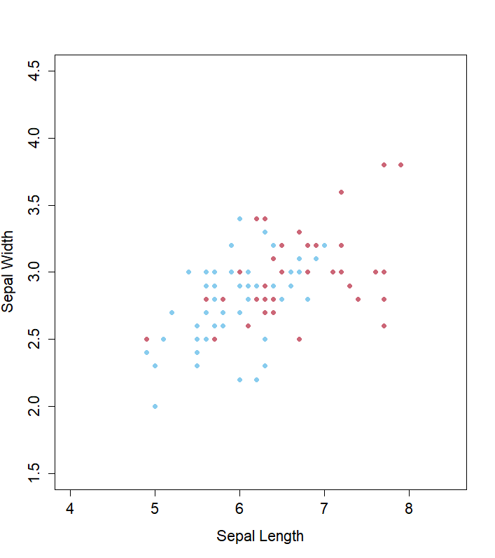
Reproduced in R

Slide 40
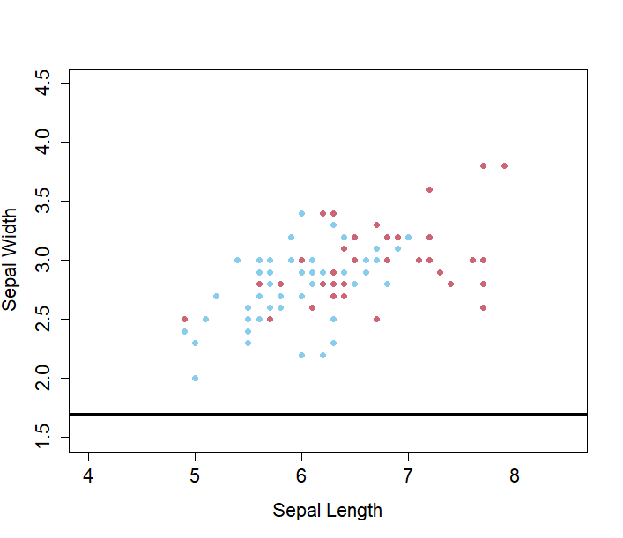
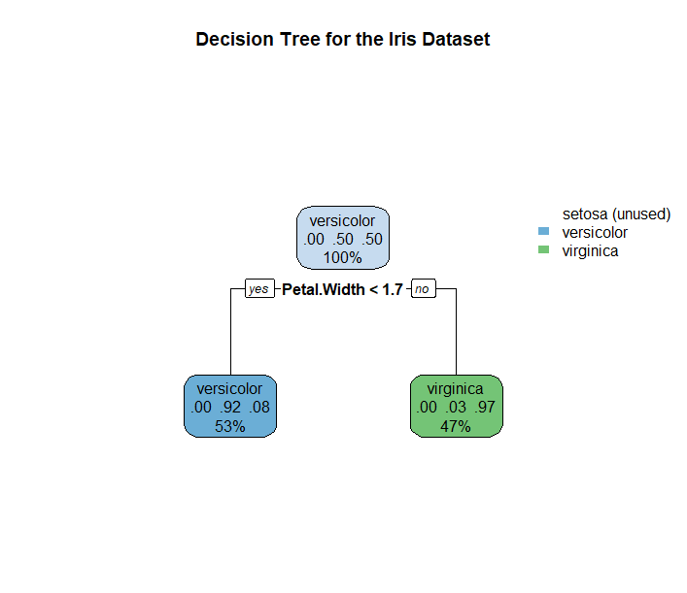
Example Code from Steve Anderson

Slide 41
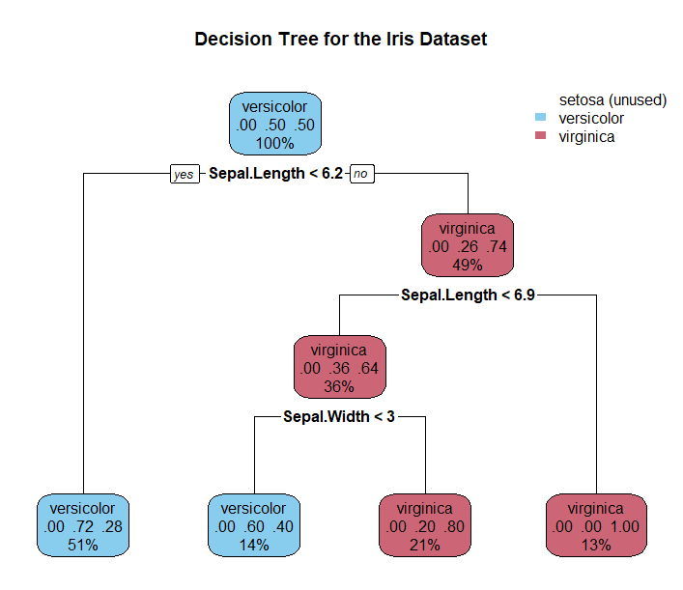
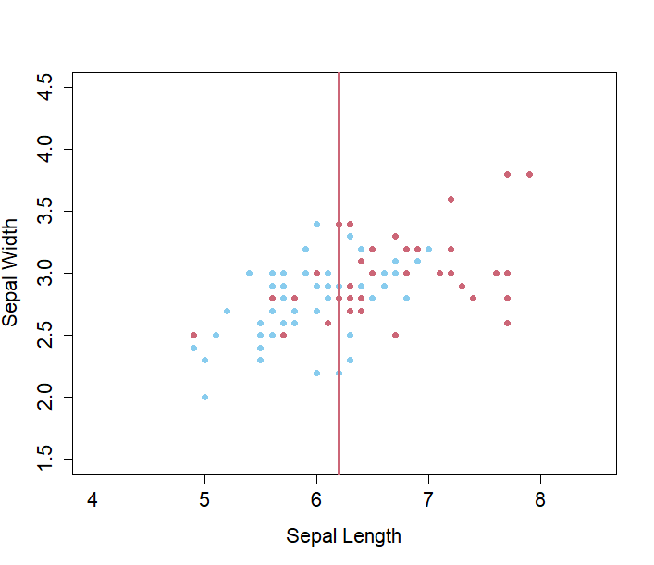
Split 1

Slide 42
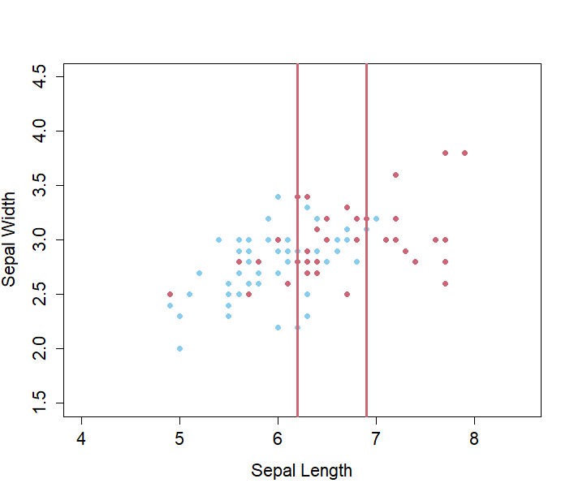
Split 2

Slide 43
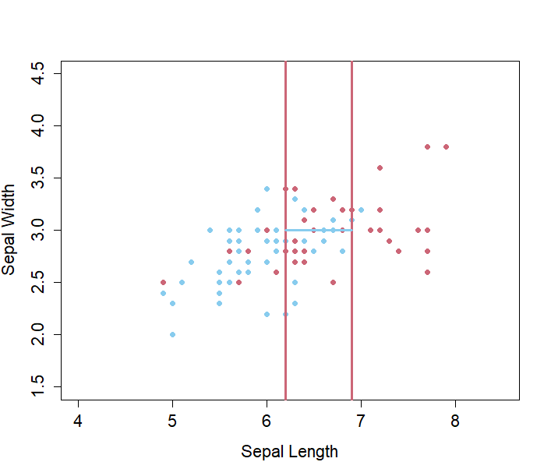
Split 3

Slide 44
Comparison with LDA

Slide 45
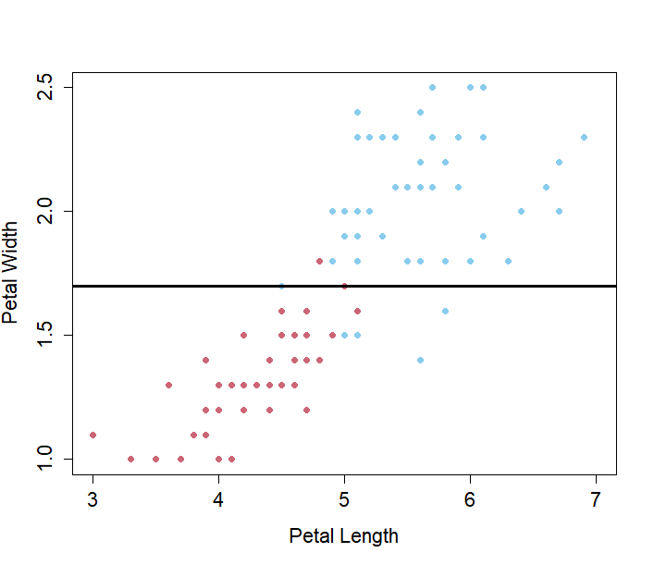
How Good Was That Other Model?

Slide 46
Why Did We Get That Weird Second Split?
…we probably didn’t.
Or possibly Simpson’s Paradox (ISDS, video 9.4)

Slide 47
Tree-Based Algorithm

Slide 48
How To Make A Decision Tree
Define a hyperspace based on your feature data

Slide 49
Model of Probability of True Outcome
$$α=0.5$$
17.9%

Slide 50
Two Predictor Variables, 3 Outcome Values (ISDS Video 9.3)

Slide 51
How To Make A Decision Tree
Define a hyperspace based on your feature data
Find a way to slice your hyperspace that minimizes your score function!
…I never finished defining score functions, did I?
Don’t worry! Now we have everything we need to understand them!

Slide 52
Score Functions

Slide 53
What are Score Functions?
The score function for regression trees is:
…
…one more detour

Slide 54
Decision Trees: Continuous Features, Continuous Response

Slide 55
Extension of Stepwise Model to Higher Dimensions
Classification Tree: Chop up parameter hyperspace based on [mumble] and predict most popular category from response variable in each region
Regression Tree: Chop up parameter hyperspace based on other [mumble] and predict mean value of response variable in each region
Just like stepwise modelling, except we’re doing it in higher dimensions

Slide 56
Back To: Score Functions

Slide 57
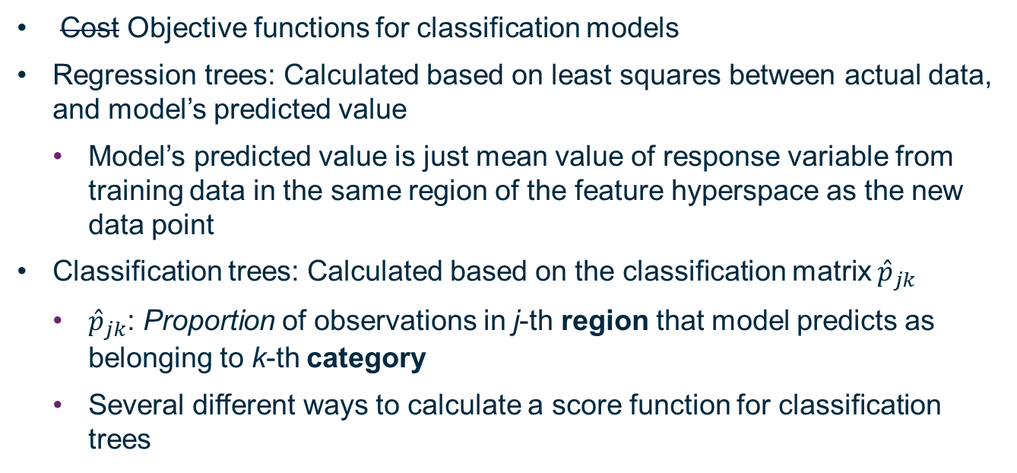
What are Score Functions? They are the [mumbles]
Cost Objective functions for classification models
Regression trees: Calculated based on least squares between actual data, and model’s predicted value
Model’s predicted value is just mean value of response variable from training data in the same region of the feature hyperspace as the new data point
Classification trees: Calculated based on the classification matrix ${\hat{p}}_{jk}$
${\hat{p}}_{jk}$: Proportion of observations in j-th region that model predicts as belonging to k-th category
Several different ways to calculate a score function for classification trees

Slide 58
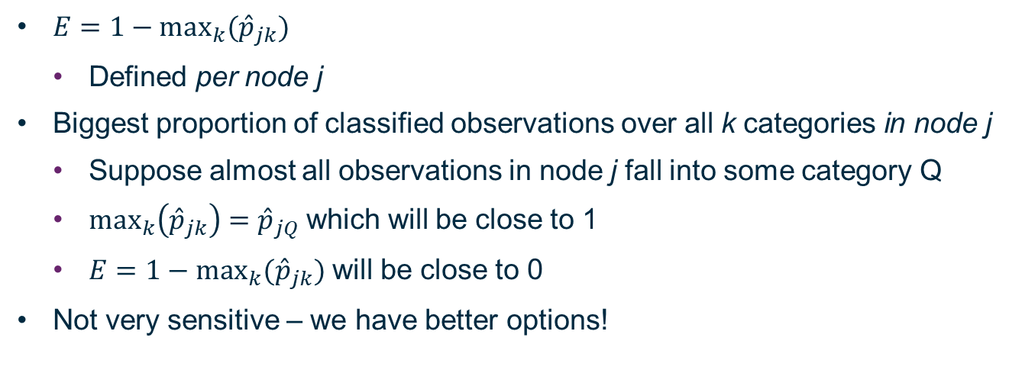
Error Rate
$E=1−\max_{k}({\hat{p}}_{jk})$
Defined per node j
Biggest proportion of classified observations over all k categories in node j
Suppose almost all observations in node j fall into some category Q
$\max_{k}\left({\hat{p}}_{jk}\right)={\hat{p}}_{jQ}$ which will be close to 1
$E=1−\max_{k}({\hat{p}}_{jk})$ will be close to 0
Not very sensitive – we have better options!

Slide 59
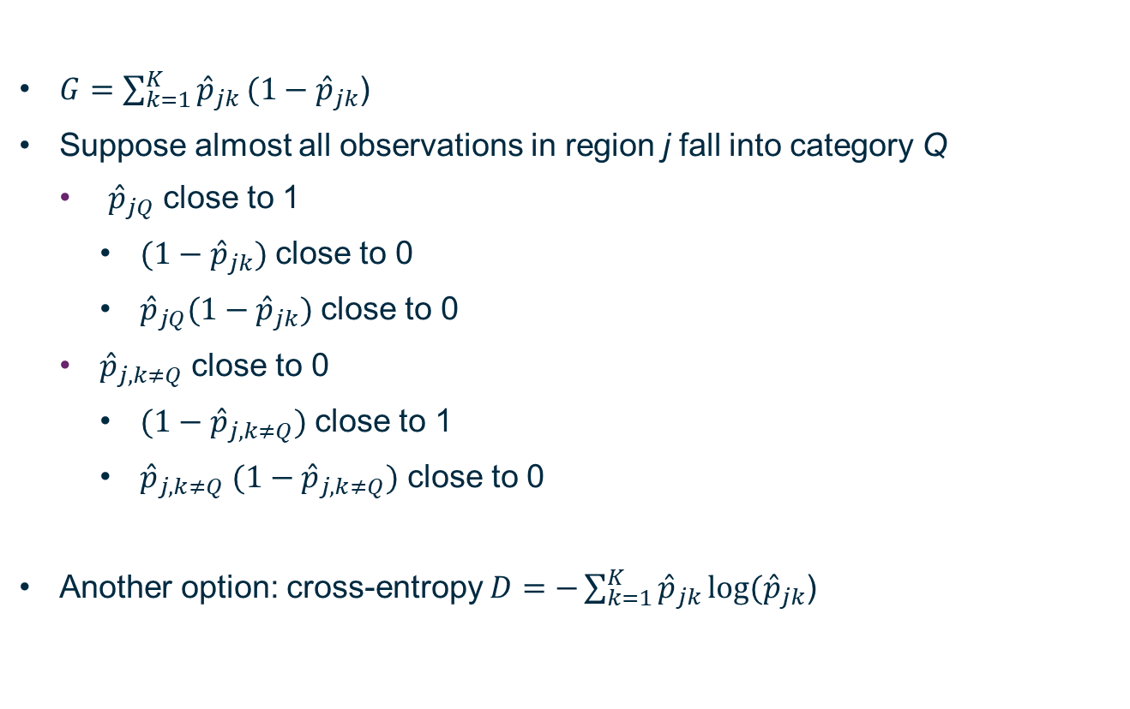
Gini Index
$G=\sum_{k=1}^{K}{{\hat{p}}_{jk}}(1−{\hat{p}}_{jk}$)
Suppose almost all observations in region j fall into category Q
${\hat{p}}_{jQ}$ close to 1
${(1−\hat{p}}_{jk})$ close to 0
${\hat{p}}_{jQ}{(1−\hat{p}}_{jk})$ close to 0
${\hat{p}}_{j,k≠Q}$ close to 0
${(1−\hat{p}}_{j,k≠Q})$ close to 1
${\hat{p}}_{j,k≠Q}$ ${(1−\hat{p}}_{j,k≠Q})$ close to 0
Another option: cross-entropy $D=−\sum_{k=1}^{K}{{\hat{p}}_{jk}}log⁡({\hat{p}}_{jk}$)

Slide 60
Back to: Tree-Based Algorithm

Slide 61
How To Make A Decision Tree
Define a hyperspace based on your feature data
Find a way to slice your hyperspace that minimizes your score function!
Or potentially maximizes it I guess
Use a recursive binary splitting technique – you’re always slicing an existing region in half along one feature variable

Slide 62

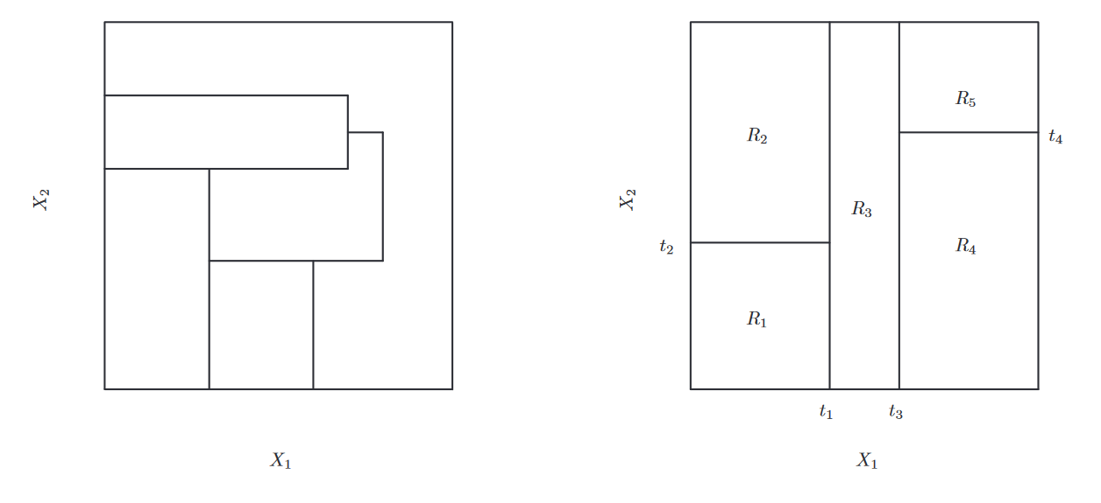

Figure 8.3
James et al.

Slide 63
How To Make A Decision Tree
Define a hyperspace based on your feature data
Find a way to slice your hyperspace that minimizes your score function!
Or potentially maximizes it I guess
Use a recursive binary splitting technique – you’re always slicing an existing region in half along one feature variable
Do this loads of times until you slice up your space into lots of very small regions with similar behaviour
…we didn’t really slice up our regions too small, though?

Slide 64
Pruning
…which we will discuss on Tuesday, along with Bootstrap/Bagging/Boosting

